Slide 1
Salient Object Detection using Superpixel
PowerUp Automation
BENGALURU
PIYUSH KUMAR
APOORV TOMAR
#UIPathDev #PowerUpAutomation

Slide 2
What is salient Object????
Salient object detection or salient region detection models, diverging from fixation prediction models, have traditionally been dealing with locating and segmenting the most salient object or region in a scene. While the notion of most salient object is sensible when multiple objects exist in a scene, current datasets for evaluation of saliency detection approaches often have scenes with only one single object.

Slide 3
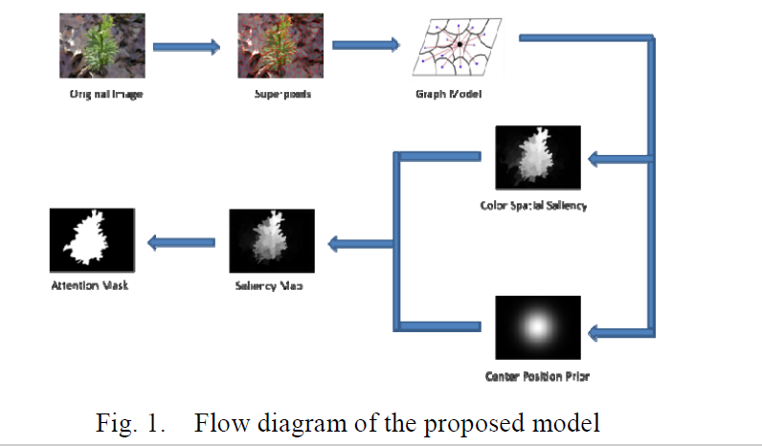
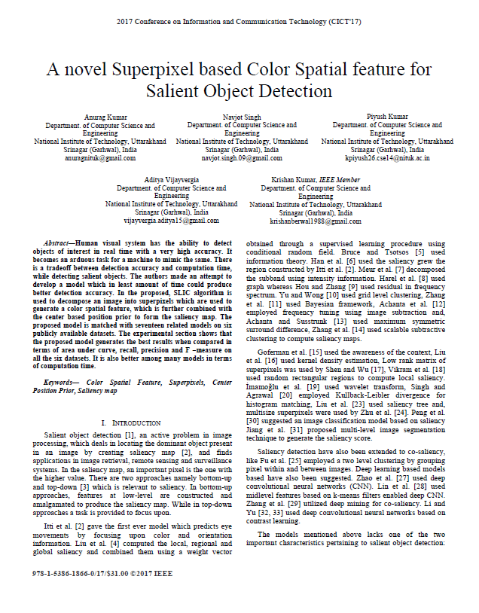
Proposed Model and Proof Of Concept
The idea has been designed using my own publication

Slide 4
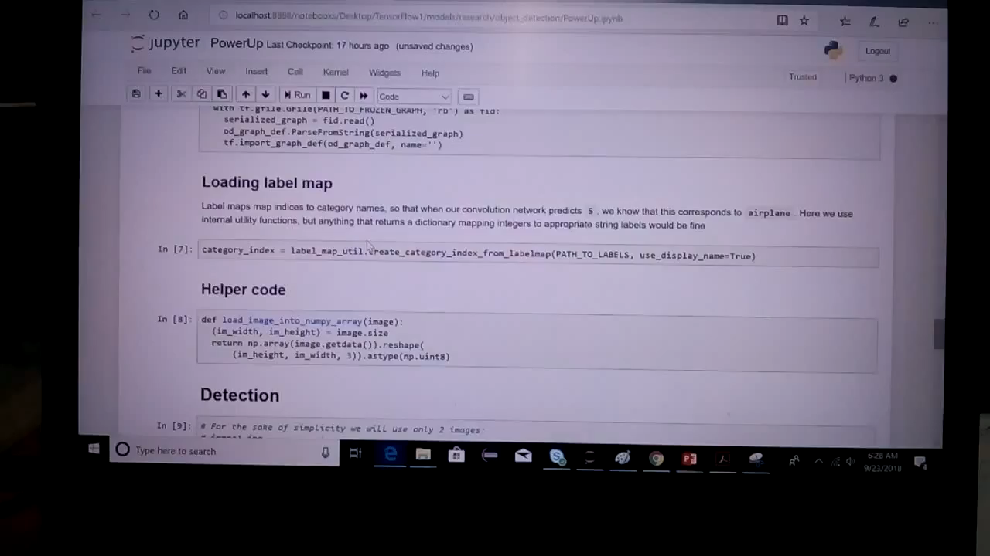
VIDEO

Slide 5
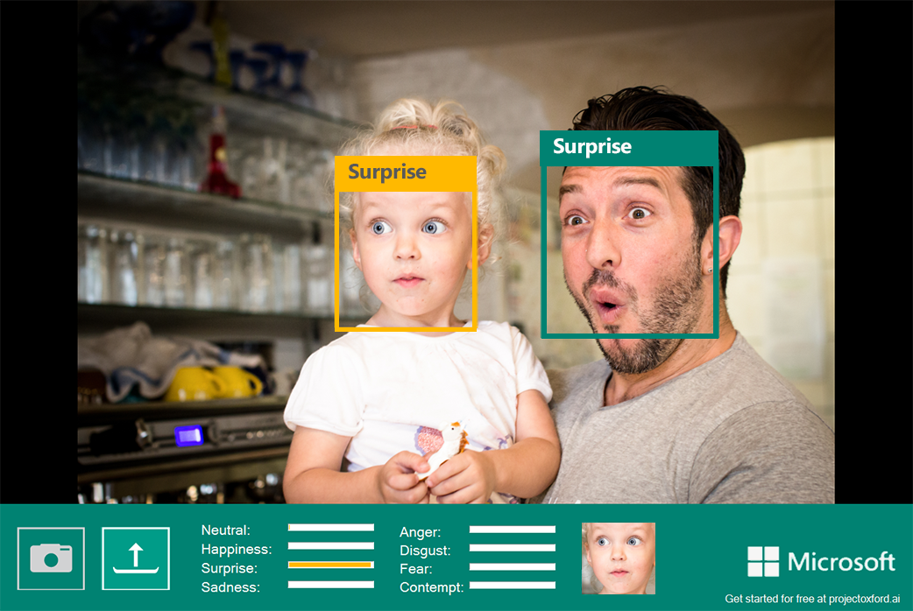

BUSINESS APPLICATION OF THE PROPOSED MODEL
The base saliency model can further to any of the following divisions:
1.Face Recognition
2.Survelliance
3.Sentiment Analysis
The Recognition model can be integrated with the UiPath studio that will give user an option to lock or unlock the designed automation tool through face detection.

